Slide 1
Description of Wikidata according to DKG schema
Tools: Protege
Krzysztof Węcel

Slide 2
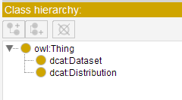
Classes added

Slide 3
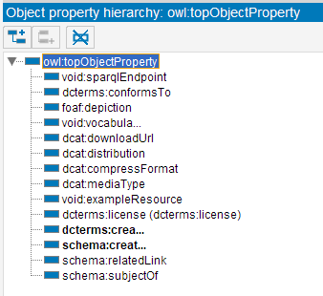
Object properties added

Slide 4
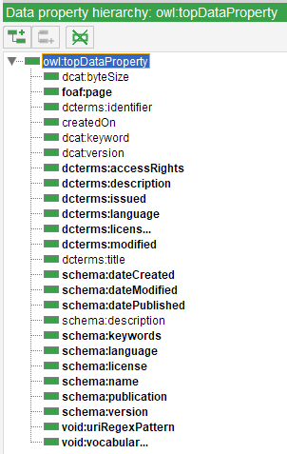
Data properties added

Slide 5
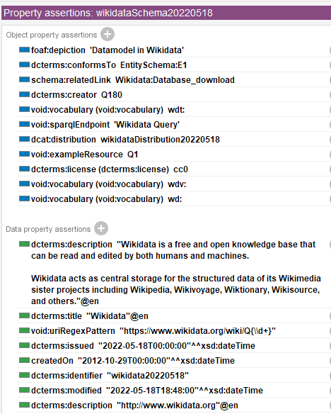
Description of the schema
dedicated entity was added: wikidataScheme20220518

Slide 6
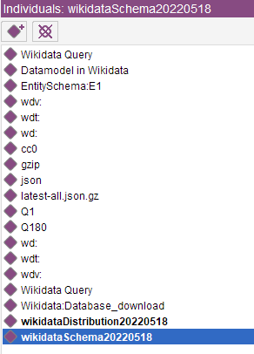
Added entities (instances)
in order to fill in object properties, we first need to add IRIs to the ontology – this is cumbersome though
IRIs ending in / need a label so that they can be displayed properly

Slide 7
Experience
each property to be used has to be first added to the ontology
decision has to be made whether it is data or object property
data properties also allow xsd:anyURI
each link (IRI) to be used has to be first added to the ontology as an instance (without type assigned)
modelling of complex objects, e.g. Distribution, is cumbersome as the object itself has to be modelled as a separate instance
lack of heavily reused annotations, like for example licenses, that had to be added manually
also, ‘standard’ values are not always straightforward, i.e., there can be many ways to express the same
basically, time consuming, but may be a little bit faster than text editor due to built-in ontology validation

